Slide 1
Presenting and Aggregating Results

Slide 2

Overview
Sorting query results
Applying aggregate calculations

Slide 3
Querying Residency
SELECT name, state
FROM residency;
name | state
Amy | Oregon
Justin | Wyoming
Sheila | Texas
Jim | Texas
Marsha | Oregon
Richard | Arizona

Slide 4

SELECT name,
state
FROM residency ORDER BY name
Residency table
name | state
Amy | Oregon
Justin | Wyoming
Sheila | Texas
Jim | Texas
Marsha | Oregon
Richard | Arizona
name | state
Amy | Oregon
Jim | Texas
Justin | Wyoming
Marsha | Oregon
Richard | Arizona
Sheila | Texas

Slide 5
Specifying Sort Order
A
Z
A
Z
1
100
1
100
Ascending Smallest to largest
Descending Largest to smallest
SORT BY ASC
SORT BY DESC

Slide 6
SELECT name,
state
FROM residency ORDER BY state, name
Residency table
name | state
Amy | Oregon
Justin | Wyoming
Sheila | Texas
Jim | Texas
Marsha | Oregon
Richard | Arizona
name | state
Richard | Arizona
Amy | Oregon
Marsha | Oregon
Jim | Texas
Sheila | Texas
Justin | Wyoming

Slide 7
SELECT name,
state
Residency table
FROM residency
ORDER BY state DESC, name ASC
name | state
Amy | Oregon
Justin | Wyoming
Sheila | Texas
Jim | Texas
Marsha | Oregon
Richard | Arizona
Name
state
Justin
Wyoming
Jim
Texas
Sheila
Texas
Amy
Oregon
Marsha
Oregon
Richard
Arizona

Slide 8
SELECT name,
state
Residency table
FROM residency
ORDER BY 2 DESC, 1 ASC
name | state
Amy | Oregon
Justin | Wyoming
Sheila | Texas
Jim | Texas
Marsha | Oregon
Richard | Arizona
Name | state
Justin | Wyoming
Jim | Texas
Sheila | Texas
Amy | Oregon
Marsha | Oregon
Richard | Arizona

Slide 9
Aggregate Functions
COUNT
SUM
AVG
MIN
MAX

Slide 10
SELECT AVG(age)
name | grade_lvl | age
Eliza | Junior | 17
Jane | Junior | 17
Leslie | Senior | 19
Matt | Junior | 16
Ned | Freshman | 15
Susie | Junior | 18
AS avg_age
FROM person;
Aggregate Functions
To use an aggregate function, include it in the SELECT clause
The above code returns an average age of 17

Slide 11



Analyzing Groups
Aggregate functions can be used for more sophisticated analysis
What is our average age by grade level?
GROUP BY keyword is used to specify groups

Slide 12
SELECT grade_lvl,
AVG(age) AS avg_age FROM person
GROUP BY grade_lvl;
◀ Aggregate average function
◀ Group results by grade level
name | grade_lvl | age
Eliza | Junior | 17
Jane | Junior | 17
Leslie | Senior | 19
Matt | Junior | 16
Ned | Freshman | 15
Susie | Junior | 18
grade_lvl | avg_age
Freshman | 15
Junior | 17
Senior | 19

Slide 13
Using GROUP BY With Aggregation
Incorrect
Correct
SELECT grade_lvl,
MIN(age) AS minimum_age FROM person;
SELECT grade_lvl,
MIN(age) AS minimum_age FROM person
GROUP BY grade_lvl;
All non-aggregate fields in the SELECT clause must be represented in the GROUP BY clause

Slide 14
Demo
Explore aggregate functions

Slide 15
Filtering Aggregate Results
WHERE
HAVING
Filter single rows
Filter aggregate results

Slide 16
SELECT grade_lvl,
AVG(age) AS avg_age FROM person
GROUP BY grade_lvl
HAVING AVG(age) < 19;
◀ HAVING clause specifies that we
want to filter aggregate values from AVG
name | grade_lvl | age
Eliza | Junior | 17
Jane | Junior | 17
Leslie | Senior | 19
Matt | Junior | 16
Ned | Freshman | 15
Susie | Junior | 18
grade_lvl | avg_age
Freshman | 15
Junior | 17

Slide 17
Demo
Using HAVING to filter results

Slide 18
Understanding Subqueries in PostgreSQL
A subquery is a query nested inside another query
Types of Subqueries
Single-row
Multiple-row
Correlated
Used to perform operations that require intermediate results.
Modularity: Break complex queries into simpler parts.
Readability: Makes queries easier to understand.
Flexibility: Can be used in SELECT, INSERT, UPDATE, DELETE statements.
Execution Time: Subqueries can be slower than joins in some cases.
Optimization: PostgreSQL may optimize subqueries for better performance.

Slide 19
Database Views in PostgreSQL
Views are created using the CREATE VIEW statement.
A view in PostgreSQL is a virtual table that represents the result of a database query. It can simplify complex queries, enhance security, and provide a consistent interface to data.
Use views to create a customized presentation of data from one or more tables.
Scenarios for Using Views:
Simplifying Complex Queries Enhancing Security Providing a Layer of Abstraction Aggregated Data Join Operations
CREATE VIEW view_name AS
SELECT column1, column2, ...
FROM table_name
WHERE condition;
DROP VIEW IF EXISTS flight_info;

Slide 20
Writing High-Performing SQL Queries
Technique
Purpose
Use Indexes Wisely
Speed up data retrieval.
Reduce I/O overhead.
**Avoid SELECT *
Optimize query performance.
Use JOINS Efficiently
Improve performance by reducing the amount of data processed.
Limit the Number of Rows Returned
Use Appropriate Data Types
Ensure efficient storage and quick access.
Write Simple and Understandable Queries
Easier to maintain and optimize.

Slide 21
Writing High-Performing SQL Queries
Technique
Purpose
Use EXISTS Instead of IN for Subqueries
Improve performance with large datasets.
Optimize Join Order in Complex Queries
Reduce the amount of data processed in joins.
Use Query Analyzer Tools
Identify and optimize slow queries.
Avoid Using Functions on Indexed Columns in WHERE Clause
Maintain index efficiency.

Slide 22
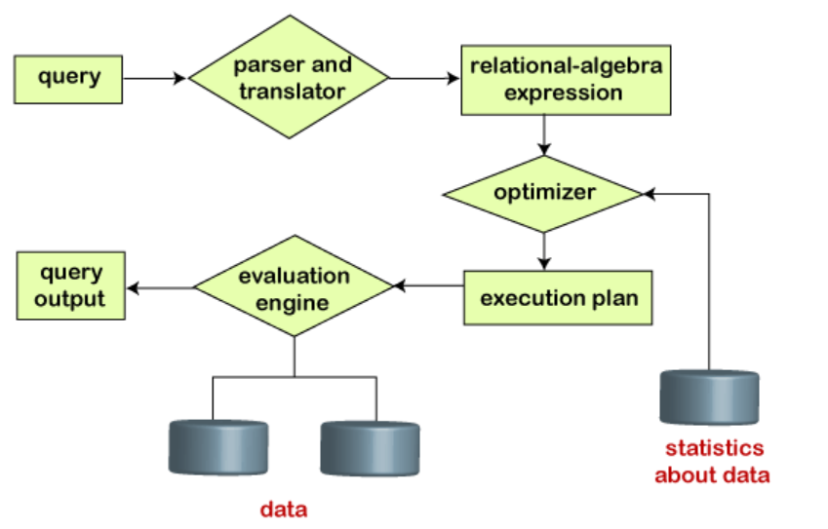
Query Plan Overview

Slide 23
Components of a Query Plan
Seq Scan (Sequential Scan)
Scans the entire table row-by-row. Suitable for small tables or when no relevant indexes exist.
Index Scan
Uses an index to quickly locate rows. Efficient for selective queries where an index exists.
Nested Loop Join
Identify Iterates over rows from one table and for each row, executes a nested query on the second table.
Hash Join
Builds a hash table from the smaller table and probes the hash table using rows from the larger table.

Slide 24
Components of a Query Plan
Merge Join
Joins two sorted datasets by merging them. Efficient for large sorted datasets.
Aggregate
Computes summary statistics like SUM, AVG, COUNT.
Sort
Orders the result set based on specified columns.
Filter
Applies conditions to filter rows.
Limit
Restricts the number of rows returned.

Slide 25
Identifying Performance Issues in SQL Queries
EXPLAIN Command
Use the EXPLAIN command to display the query plan.
EXPLAIN ANALYZE
Provides actual execution statistics along with the query plan. Useful for identifying performance bottlenecks.

Slide 26
Common Performance Issues
Full Table Scans
When the database scans the entire table because no appropriate index is available.
High Cost Operations
Steps in the query plan with high cost values indicate potential bottlenecks.
Join Order
Inefficient join order can cause excessive data processing.
Missing Indexes
Lack of indexes on columns used in WHERE, JOIN, and ORDER BY clauses.
Unoptimized Subqueries
Correlated subqueries can be inefficient if not optimized properly.

Slide 27
Introduction to Window Functions
A window function performs a calculation across a set of rows (the "window") that are related to the current row.
Key Difference vs. GROUP BY:
GROUP BY: Collapses multiple rows into a single result row.
Window Function: Retains the identity of individual rows while appending the result of the calculation to each row.
Components of the OVER Clause: PARTITION BY: Divides the result set into groups (partitions). The function is applied to each partition separately. If omitted, the entire result set is treated as one partition.
ORDER BY: Defines the logical order in which the function processes rows within a partition. This is crucial for functions like RANK() or running totals.
Frame Clause: Defines a subset of the partition (e.g., "the last 3 rows" or "all rows from the start to the current row").
Basic Syntax
The defining feature of a window function is the OVER clause.
SELECT
column_name,…,
FUNCTION_NAME() OVER (
[PARTITION BY column_1, column_2, ...]
[ORDER BY column_A [ASC|DESC]]
[frame_clause]
) AS alias_name
FROM table_name;

Slide 28
Common Window Functions
Ranking Functions
Used to assign a number or rank to rows within a partition.
Function | Description
ROW_NUMBER() | Assigns a unique, sequential integer to rows (1, 2, 3, 4).
RANK() | Assigns a rank with gaps (1, 2, 2, 4) if there are ties.
DENSE_RANK() | Assigns a rank without gaps (1, 2, 2, 3) if there are ties.
NTILE(n) | Divides the partition into n buckets and assigns a bucket number to each row.
Value Functions
Used to access data from other rows without using a Self-Join.
Function | Description
LAG(column, offset) | Returns the value from a row "behind" the current row.
LEAD(column, offset) | Returns the value from a row "ahead" of the current row.
FIRST_VALUE() / LAST_VALUE() | Returns the value from the first or last row of the window frame.

Slide 29
The Window Frame (ROWS & RANGE)
Common Frame Definitions:
Function | Description
ROWS BETWEEN UNBOUNDED PRECEDING AND CURRENT ROW | From the start of the partition to the current row (Default for ORDER BY).
ROWS BETWEEN 3 PRECEDING AND CURRENT ROW | The current row plus the three rows immediately above it.
ROWS BETWEEN CURRENT ROW AND UNBOUNDED FOLLOWING | From the current row to the end of the partition.

Slide 30
Practical Example: Running Total
SELECT
region,
sale_date,
amount,
SUM(amount) OVER (
PARTITION BY region
ORDER BY sale_date
) AS running_total
FROM sales;
PARTITION BY region: The calculation resets every time the region changes.
ORDER BY sale_date: Ensures the sum is added chronologically.
The Result: Each row shows its specific amount plus the sum of all previous amount values in that region.

Slide 31
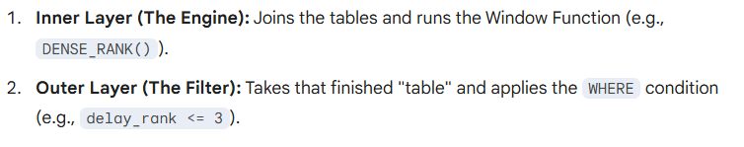
Execution Order & The WINDOW Clause
Logical Query Processing Order
Window functions are calculated late in the query execution process. This determines where they can and cannot be used.
The Pipeline:
FROM / JOIN
WHERE
GROUP BY
HAVING
➜ Window Functions
SELECT / DISTINCT
ORDER BY
LIMIT / OFFSET
Key Constraint: Filtering
The Problem: Because window functions execute after the WHERE clause, you cannot filter by a windowed result directly (e.g., WHERE rank < 3 will fail).
The Solution: Wrap the query in a CTE or Subquery.
“Calculate the window value in an inner layer, then filter in the outer layer.”

Slide 32
Demo
Ranking the Most Delayed Flights per Carrier
Scenario: The operations team wants to identify the top 3 flights with the highest departure delays for each airline to investigate the causes.

Slide 33
Demo
Comparative Analysis (Daily Delay vs. Carrier Average)
Scenario: You want to see every individual flight's delay and immediately know how it compares to that specific airline's overall average delay for that day.

Slide 34
Summary
ORDER BY sorts query results
Aggregate functions perform calculations
On entire data set
On groups specified using GROUP BY
HAVING filters aggregate results

